Slide 1
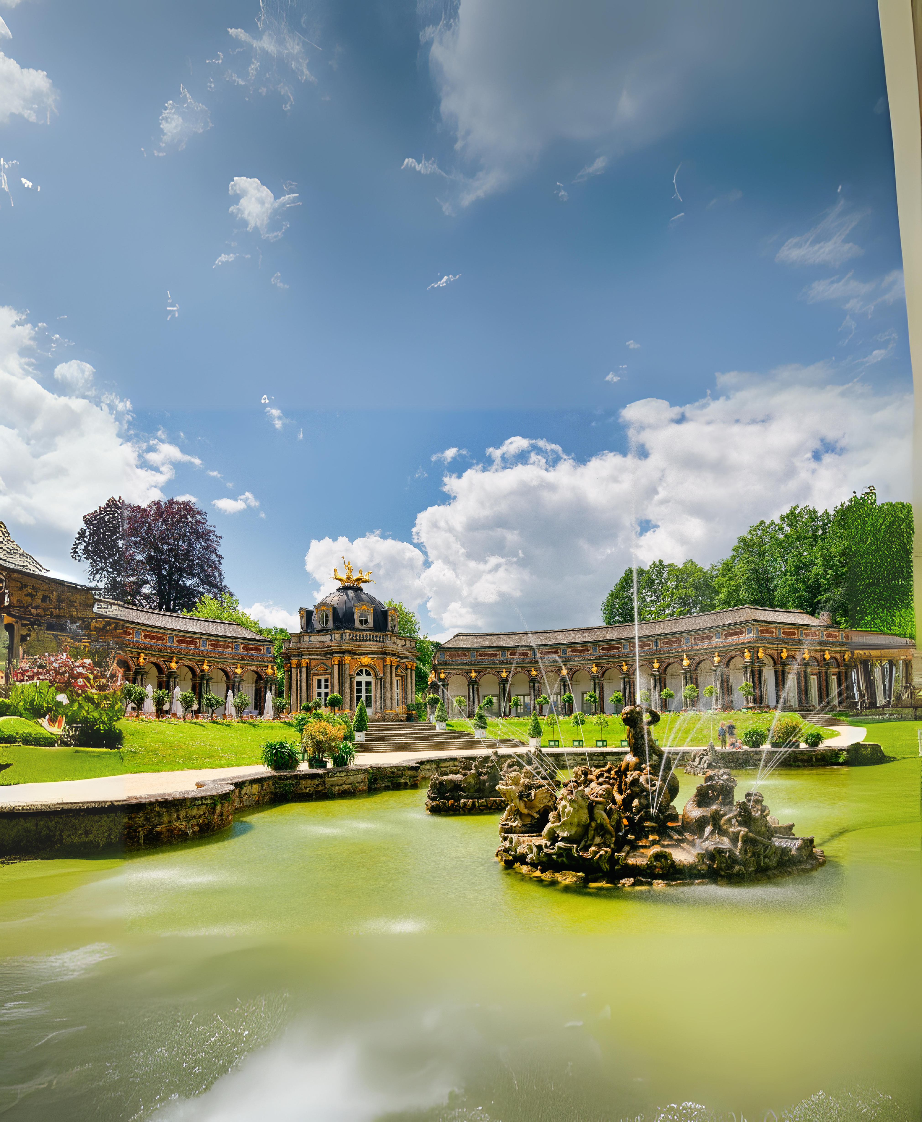

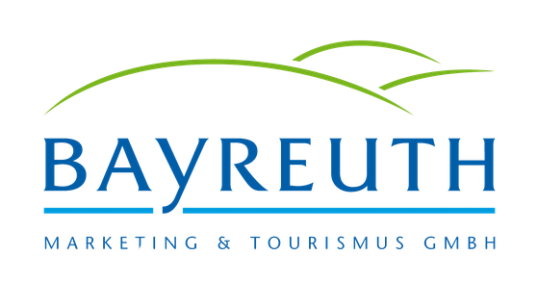
Dr. Manuel Becher
#UNEXPECTED
BAYREUTH
(c) Butovksiy

Slide 2
LOCATION
In the heart of Germany
Distances:
Munich: 2 hours
Frankfurt: 2,5 hours
Prague: 2,5 hours
Berlin: 3,5 hours

Slide 3
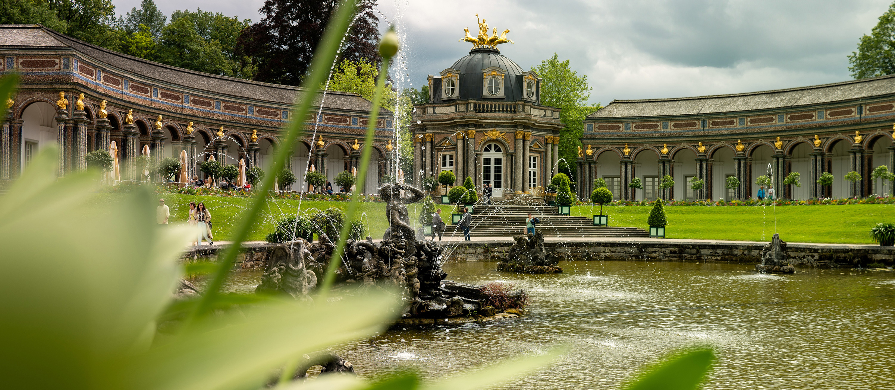
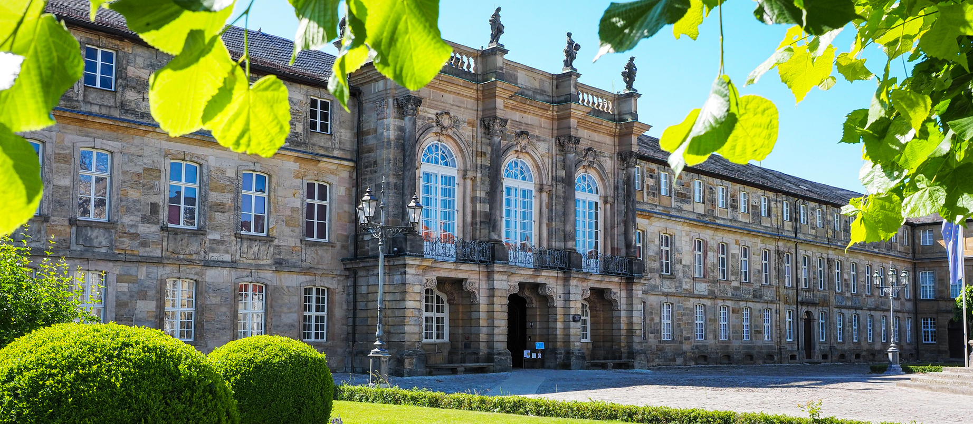
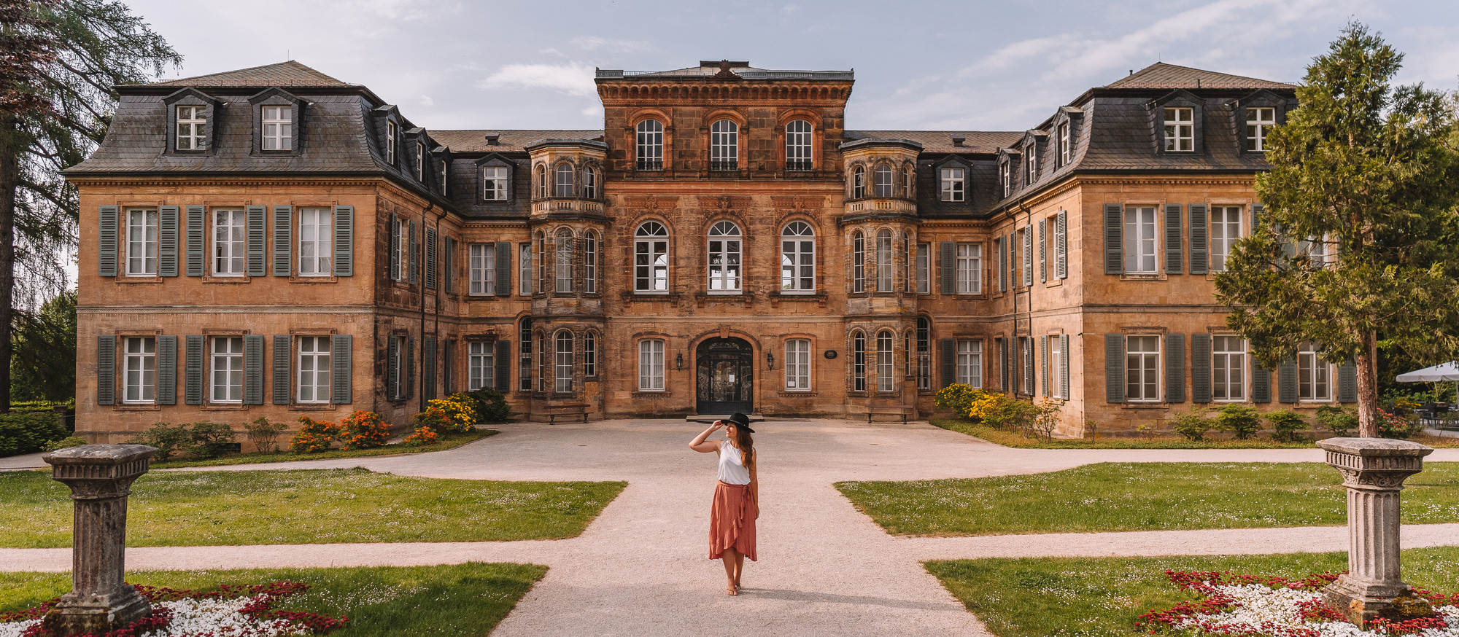
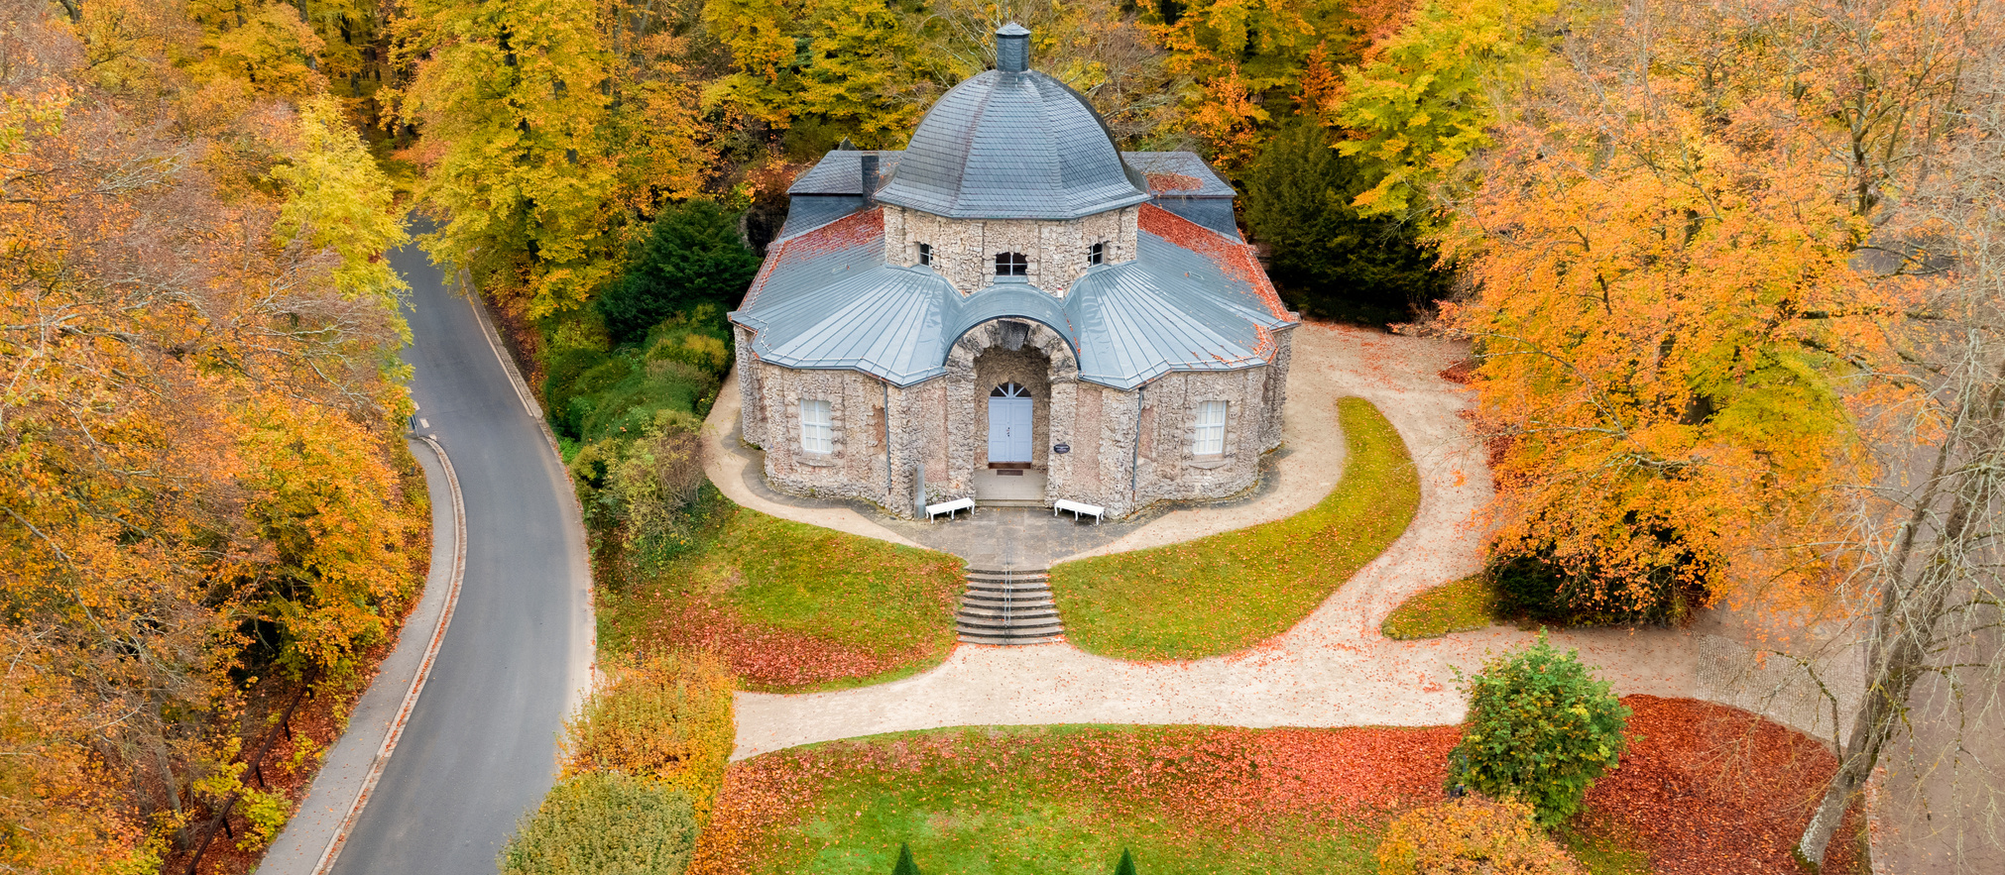
#UNEXPECTED
amazing
(c) Schillinger
(c) Bayer. Schlösserverwaltung
WILHELMINE´S WORLD
EREMITAGE
PALACE FANTAISIE
NEW PALACE
SANSPAREIL

Slide 4
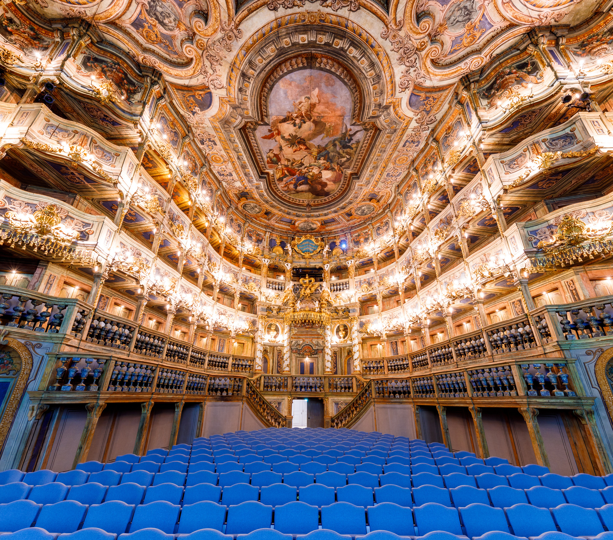
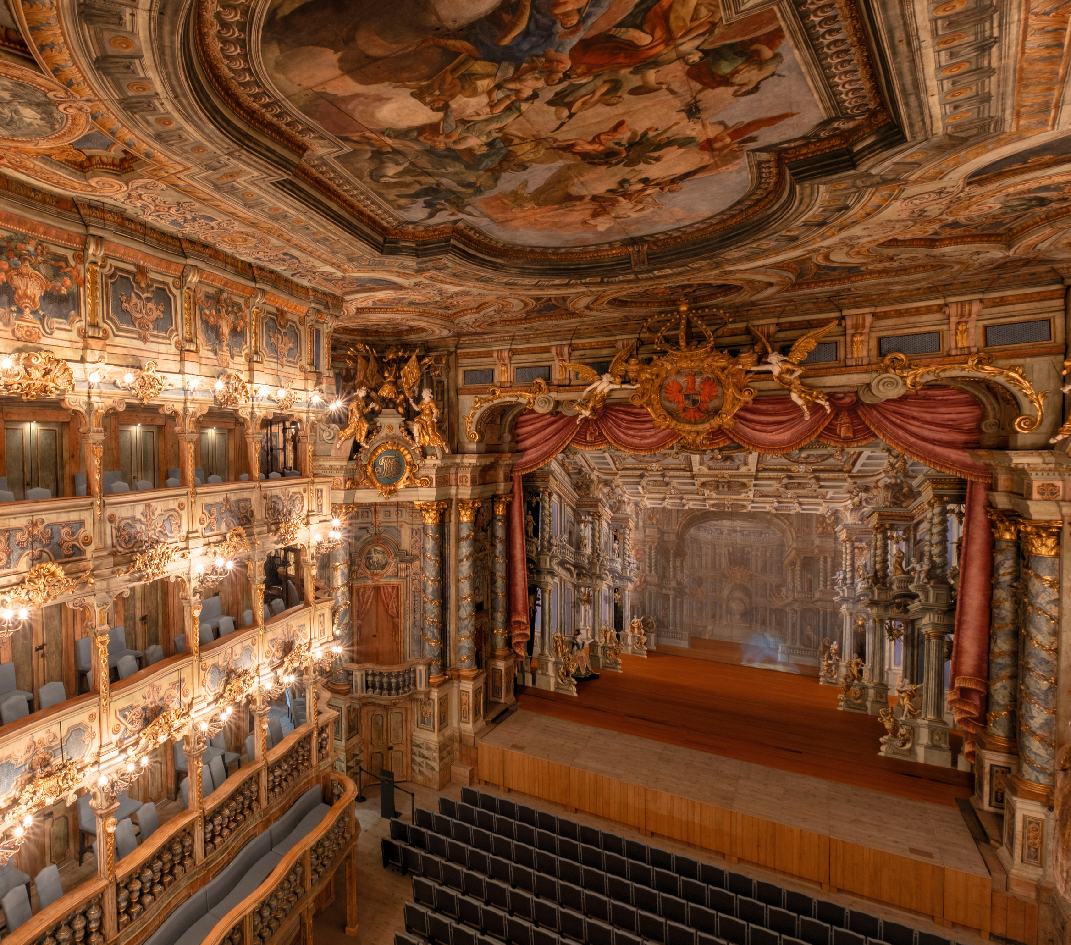
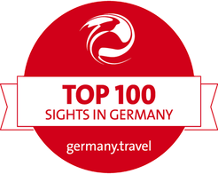

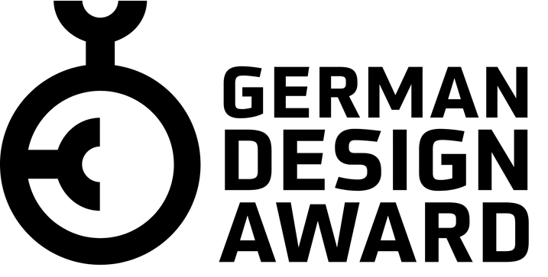
#UNEXPECTED
amazing
Highlights
BAYREUTH BAROQUE
MUSICA BAYREUTH
GUIDED TOURS
(c) Lagarde
(c) Bonin
MARGRAVIAL OPERA
UNESCO WORLD HERITAGE
1749 BUILD
2012 WORLD HERITAGE STATUS
2023 MUSEUM AND VISITOR CENTER

Slide 5
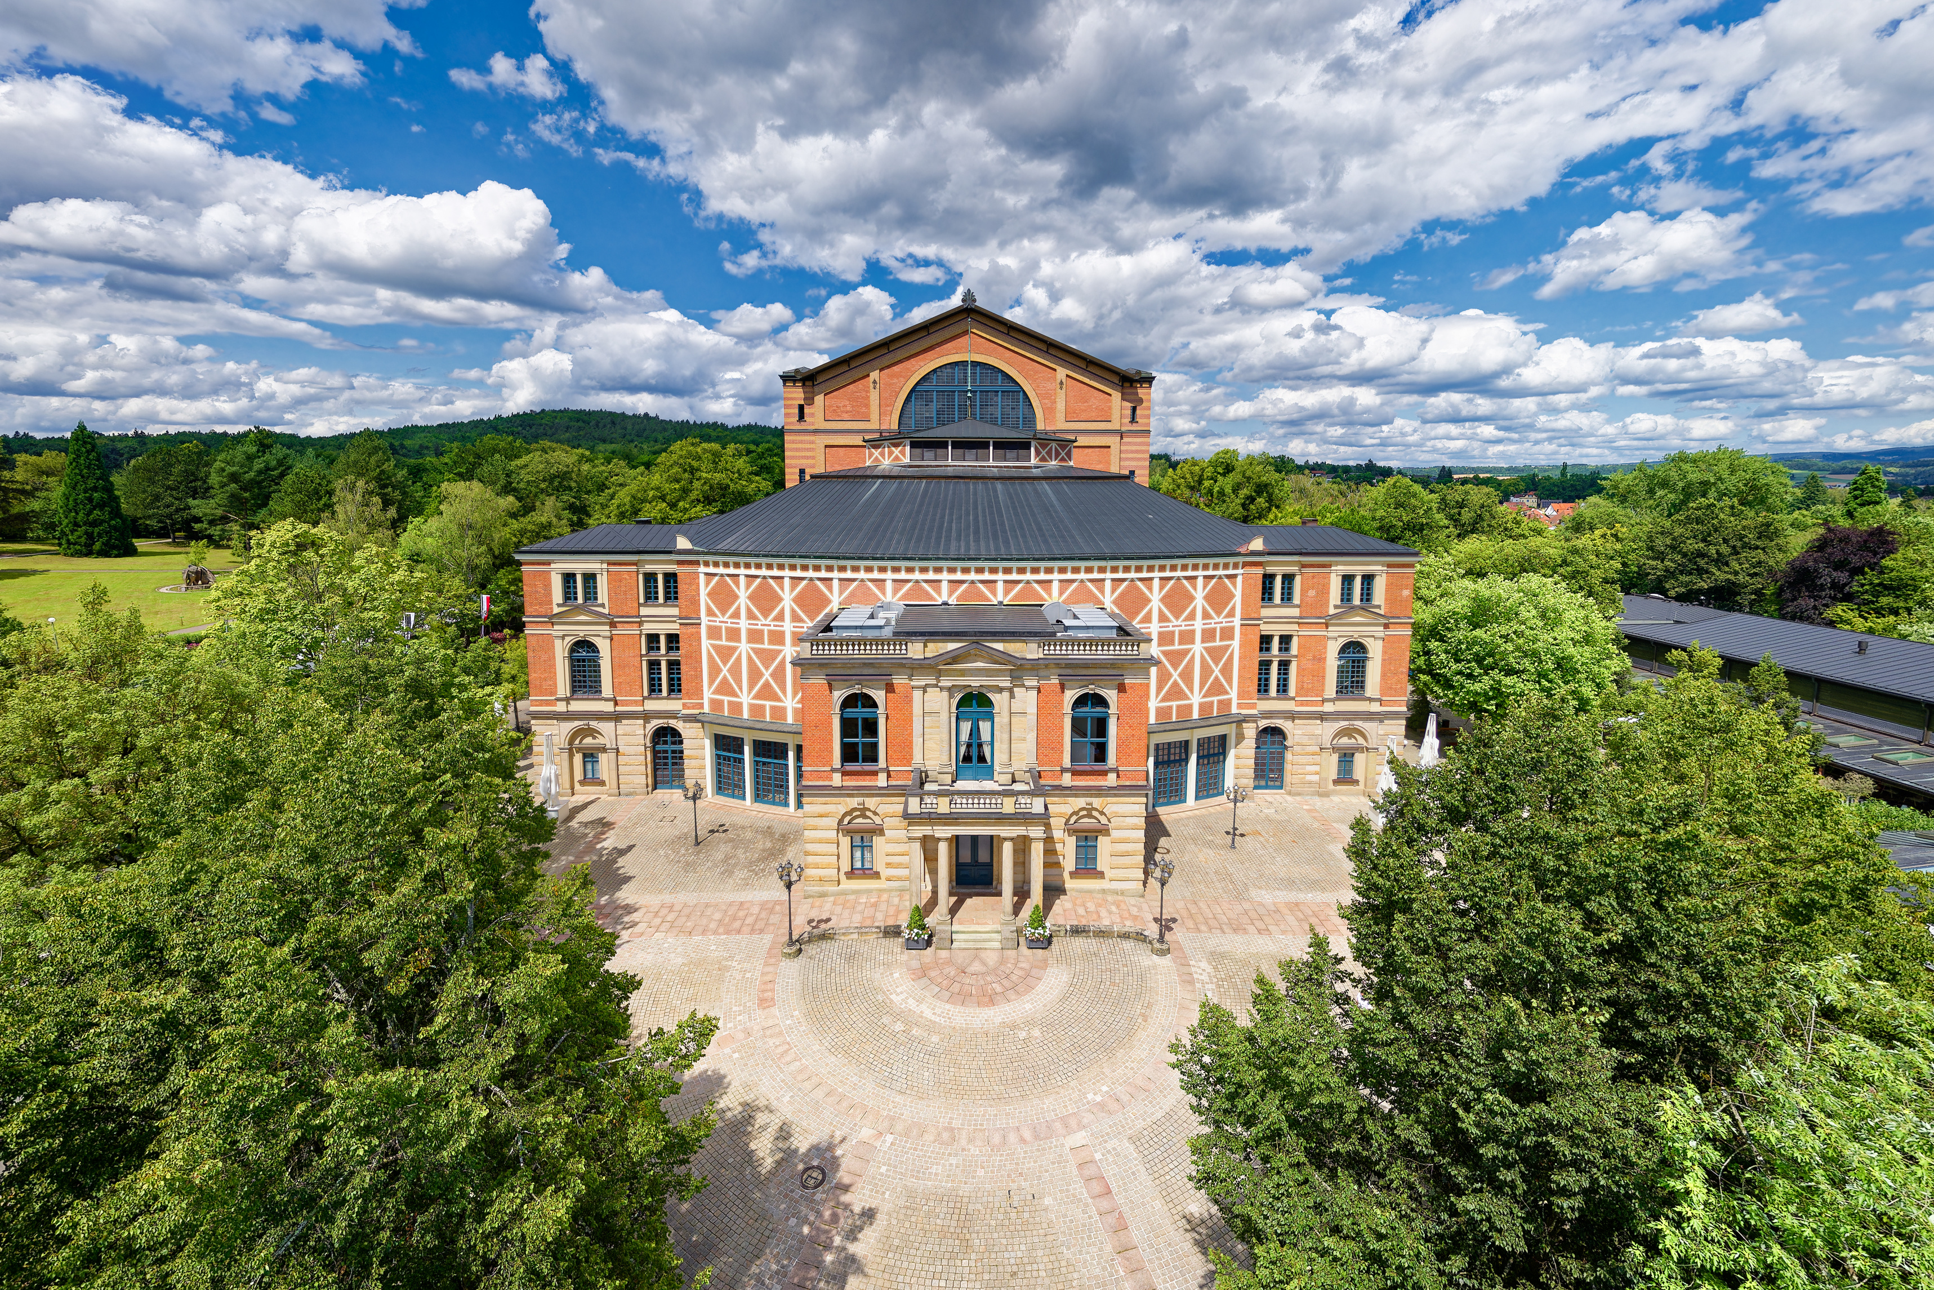
#UNEXPECTED
amazing
Highlights
RICHARD WAGNER FESTIVAL
EXLUSIVE GUIDED TOURS
(c) Butovskiy
RICHARD WAGNER FESTIVAL THEATER
HOME TO THE WORLD´S LONGEST-RUNNING OPERA FESTIVAL
ANNUAL RICHARD WAGNER FESTIVAL FROM JULY-AUGUST
2026: 150 JUBILEE OF THE FESTIVAL

Slide 6
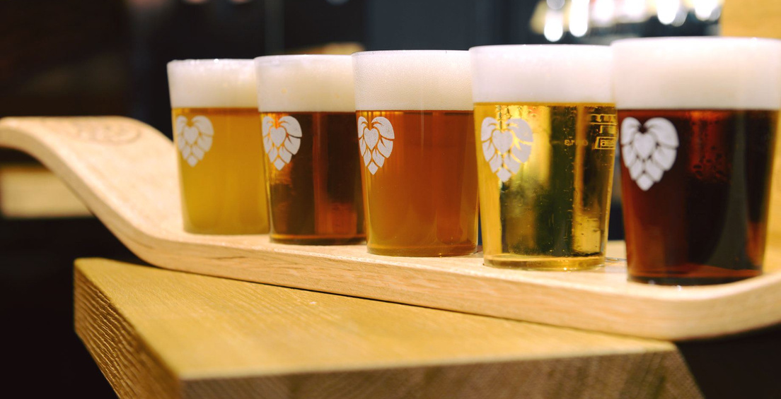
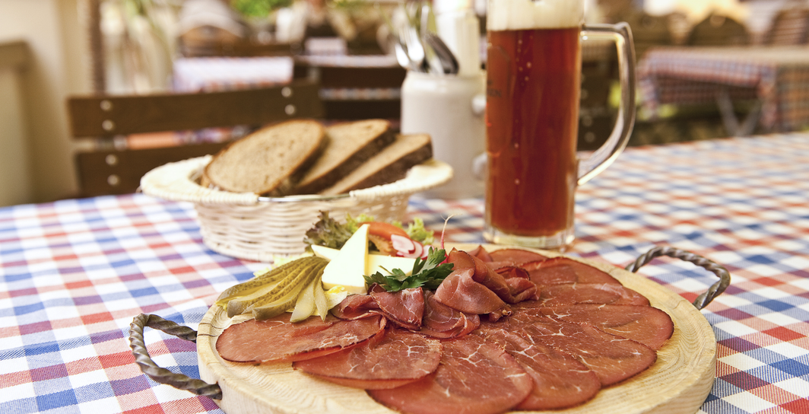
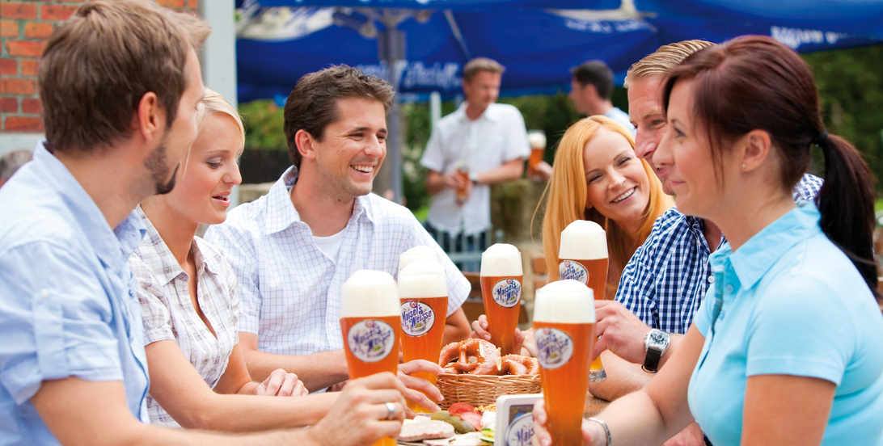
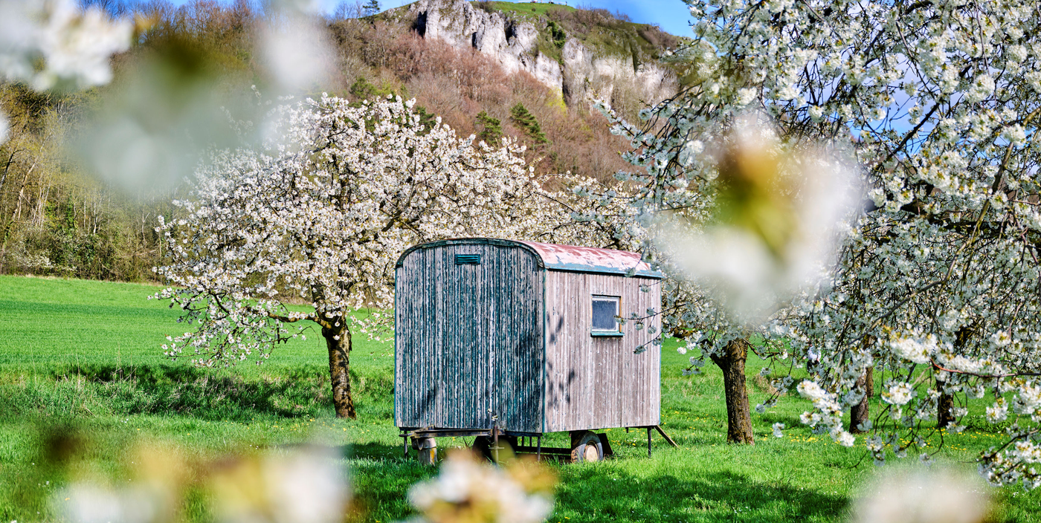
#UNEXPECTED
taste
Land of Breweries
(c) Maisel
(c) Genussregion Oberfranken
Land of Butcher Shops and Bakeries
Over 200 breweries are located in the Upper Franconia region, brewing more than 1,000 different beers.
Over 200 breweries are located in the Upper Franconia region, brewing more than 1,000 different beers.
Bayreuth Beer Culture
(c) Maisel
Land of Distilleries
(c) Trykowski
In Bayreuth, beer culture holds great significance. Here, you'll find both small local breweries and internationally established ones, as well as unique places that make the beer experience truly memorable.
The region is also renowned for its impressive number of distilleries. From traditional family-run schnapps producers to innovative craft spirit makers, visitors can discover a rich variety of flavors and distilling traditions.

Slide 7
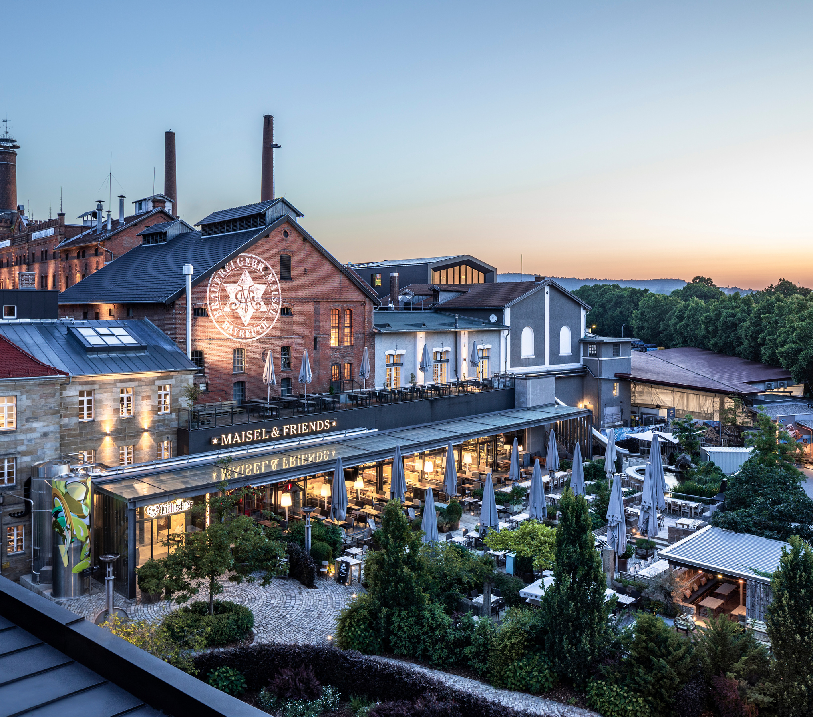
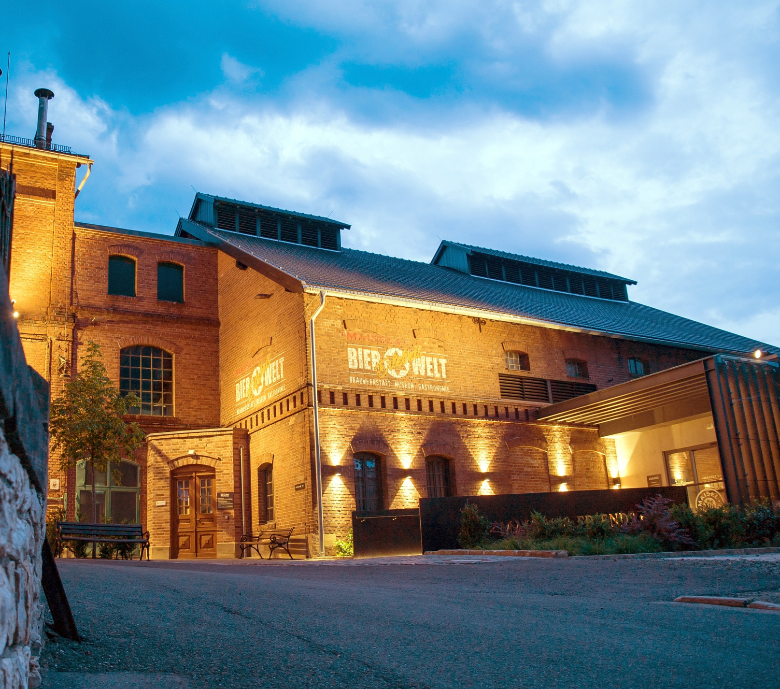
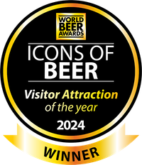
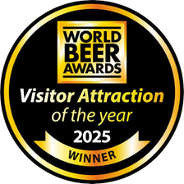
#UNEXPECTED
taste
Highlights
BREWING WORKSHOPS
URBAN ART
GUIDED TOURS
(c) Maisel
MAISEL AND FRIENDS
WORLDS MOST COMPREHENISVE BREWERY MUSEUM
2024 & 2025 VISITOR ATTRACTION OF THE YEAR (WORLD BEER AWARDS)
URBAN ART HOTEL
AWARD WINNING BEERS

Slide 8
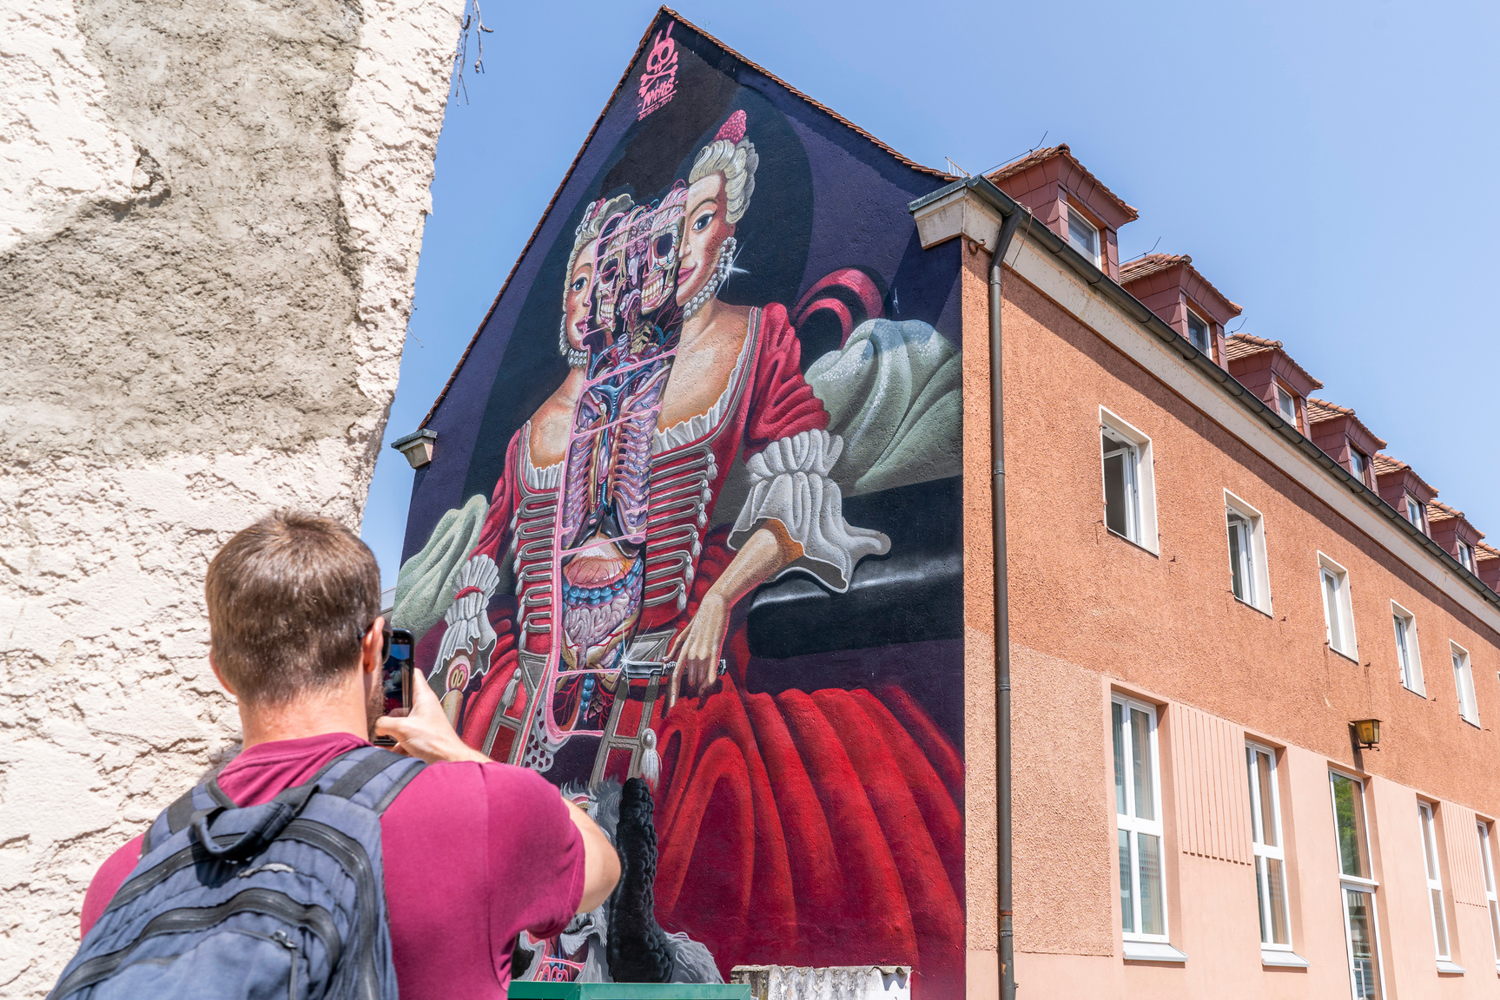
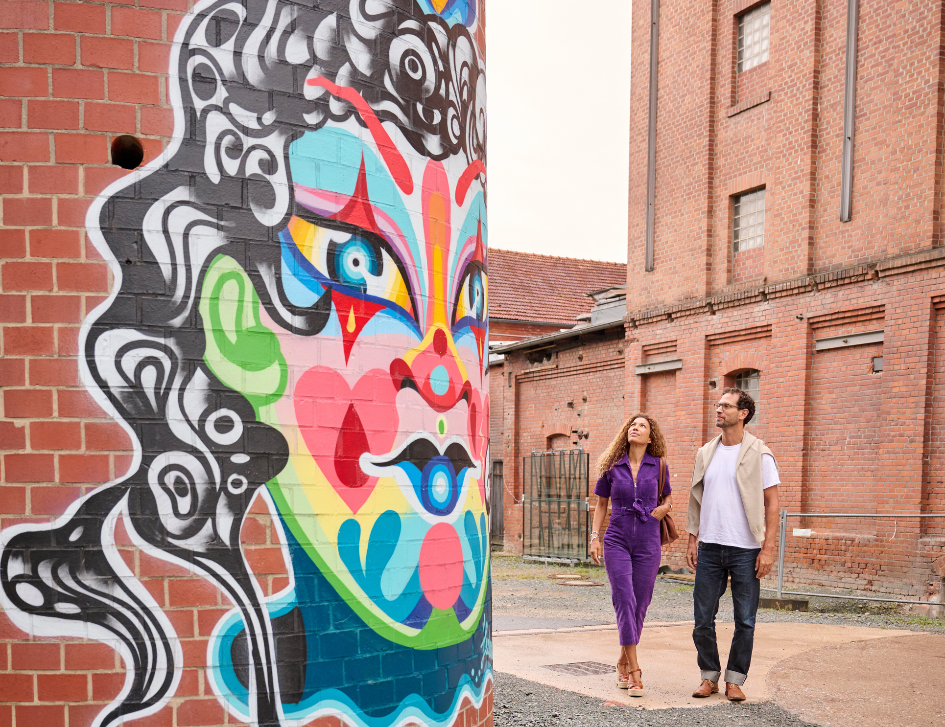
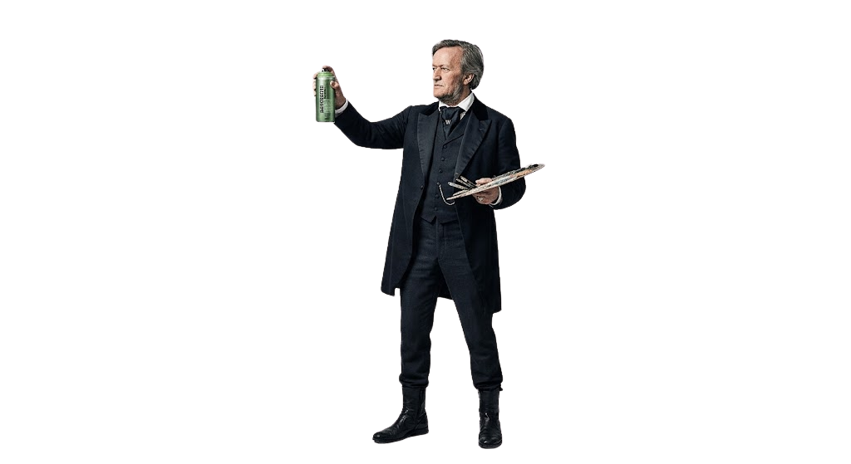

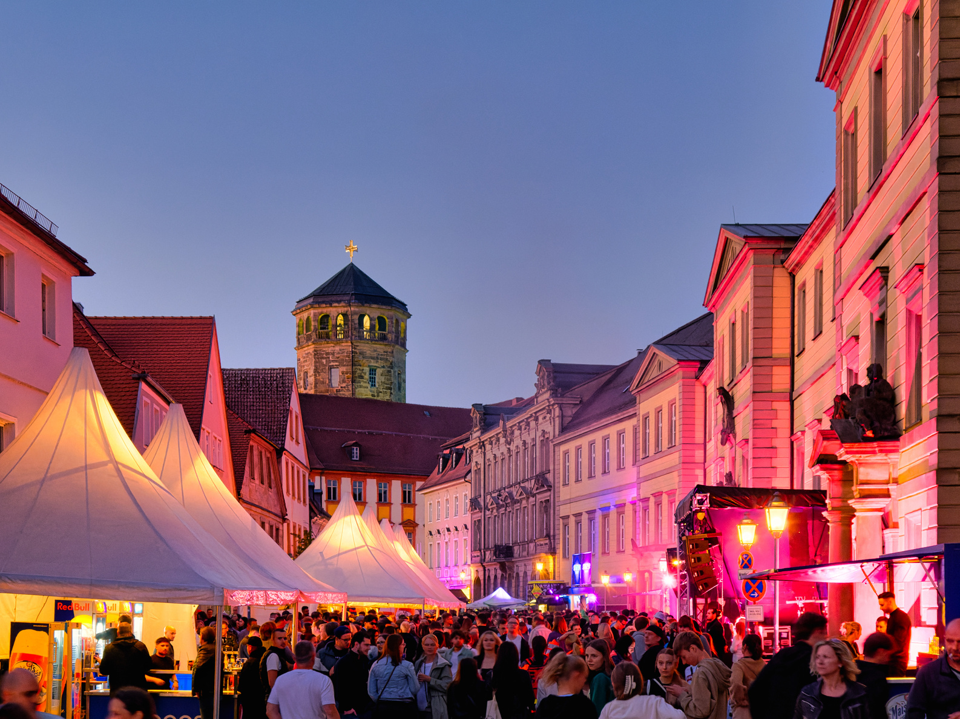
#UNEXPECTED
urban
(c) Kommwirmachendaseinfach
Urban Art
Bayreuth surprises visitors with a dynamic urban art scene alongside its classical heritage. From vibrant large-scale murals by international street artists to the Liebesbier Urban Art Hotel, travelers discover a creative and modern open-air culture.
(c) Jens Wegener
Events
The city thrives as a versatile event hub with an inspiring calendar all year round. From open-air festivals and contemporary art events to lively cultural celebrations, visitors can experience an energetic atmosphere that goes far beyond classical opera.
AI GENERATED
(c) Butovskiy

Slide 9
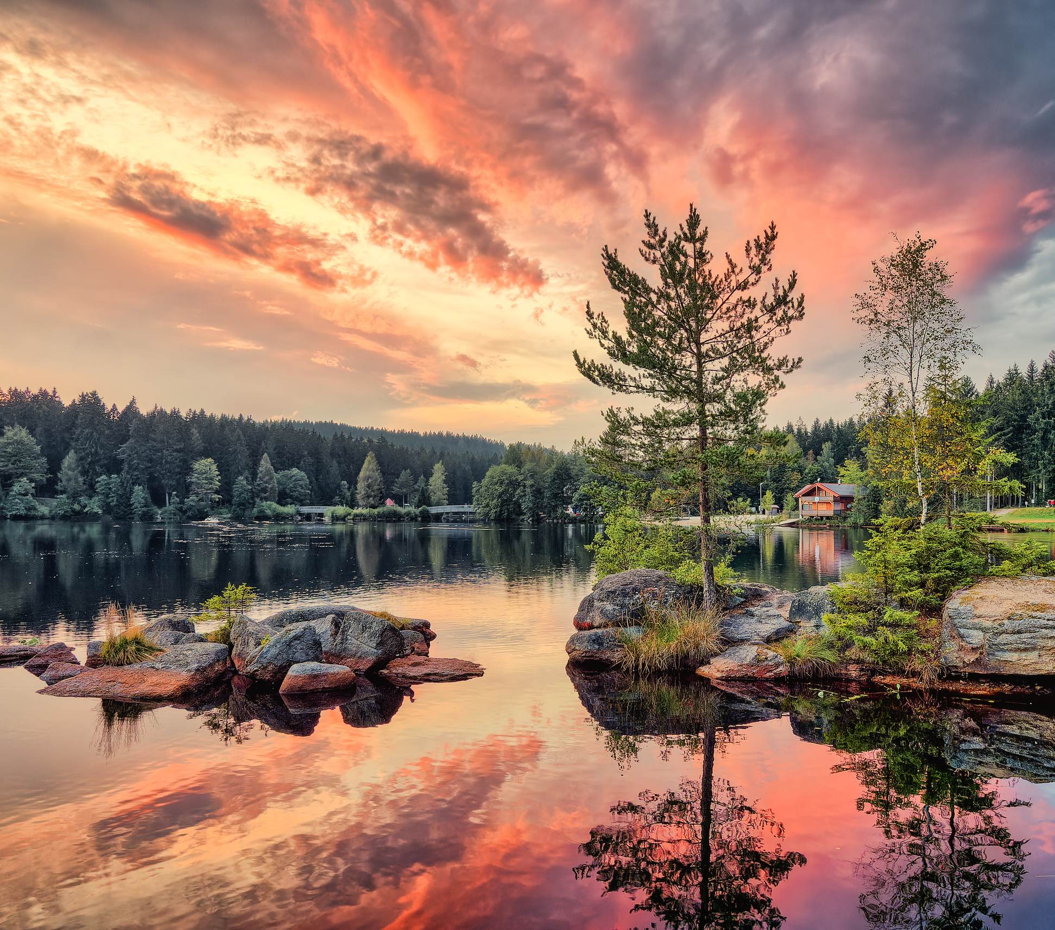
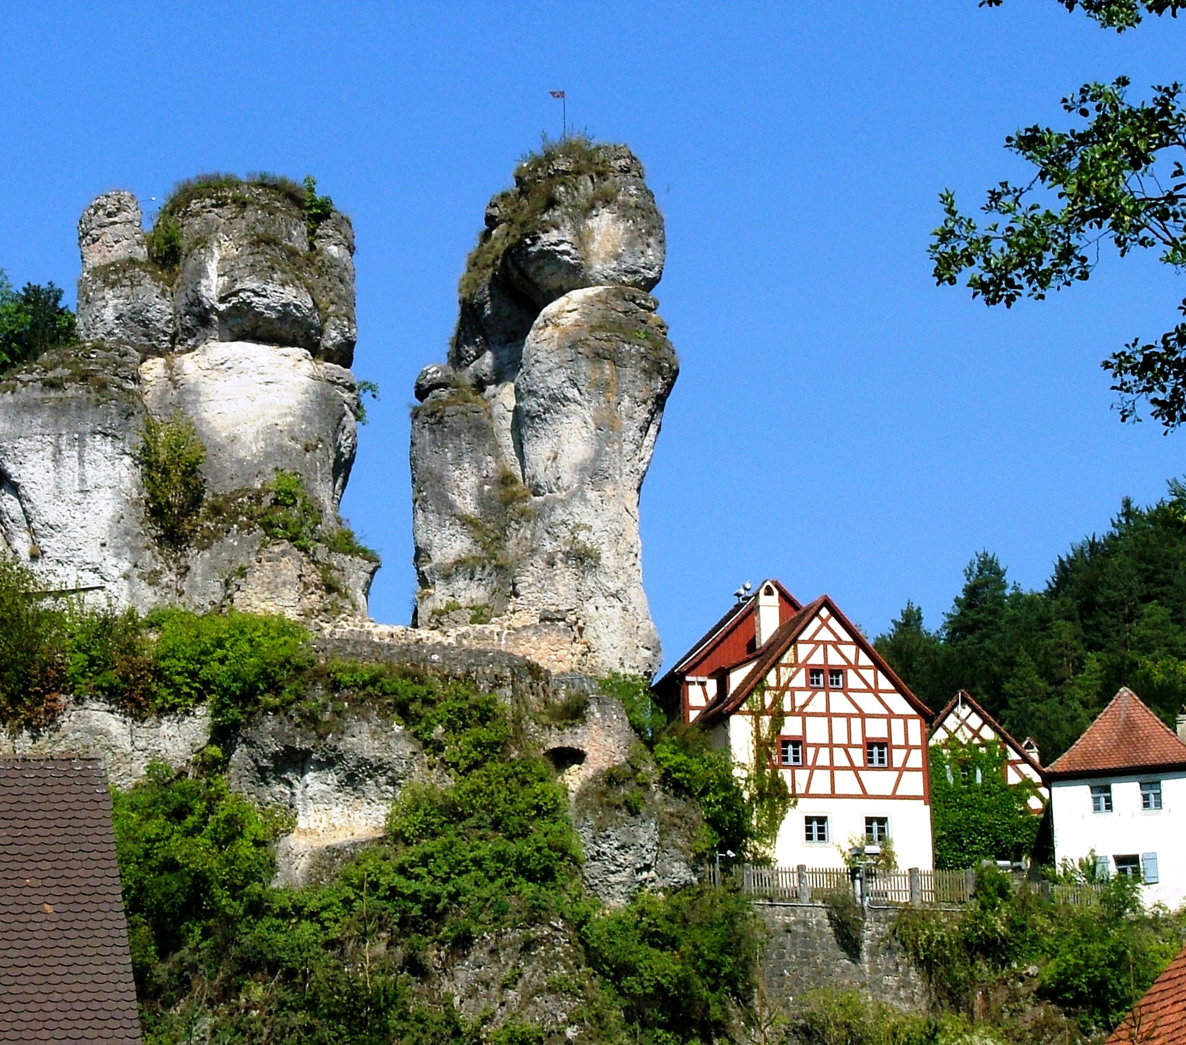
#UNEXPECTED
possibilities
(c) Butovskiy
(c) Tourismusbüro Pottenstein
FICHTEL MOUNTAINS
FICHTELSEE
FRANCONIAN SWITZERLAND
TÜCHERSFELD
18 miles
from Bayreuth
17 miles
from Bayreuth

Slide 10
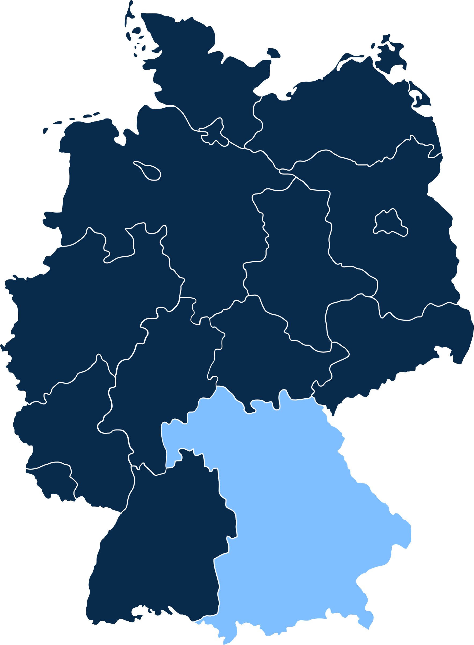





UNESCO SITES
Weimar
Eisenach
Karlovy Vary
Bad Kissingen
Würzburg
Bayreuth
Bamberg
Nuremberg
Rothenburg
Regensburg

Slide 11
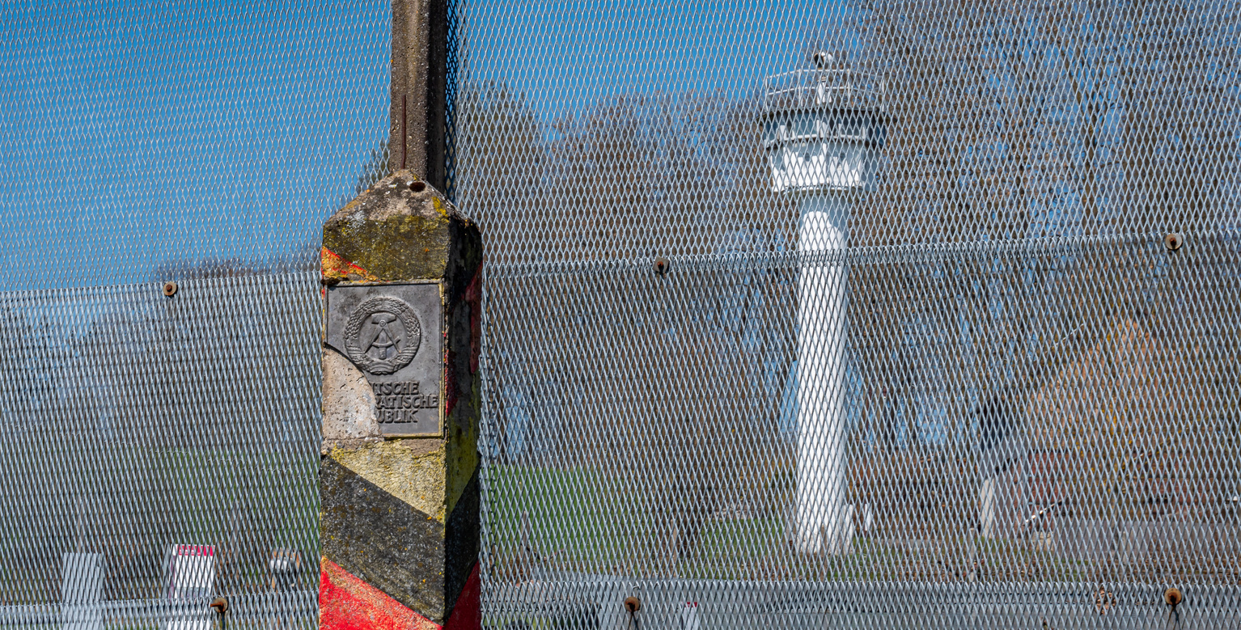
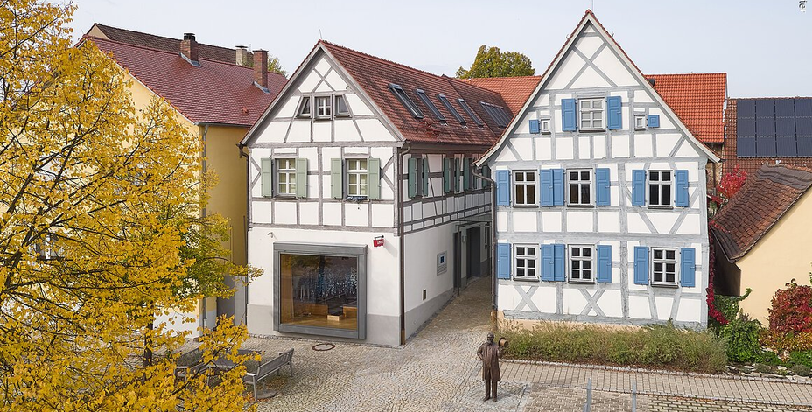
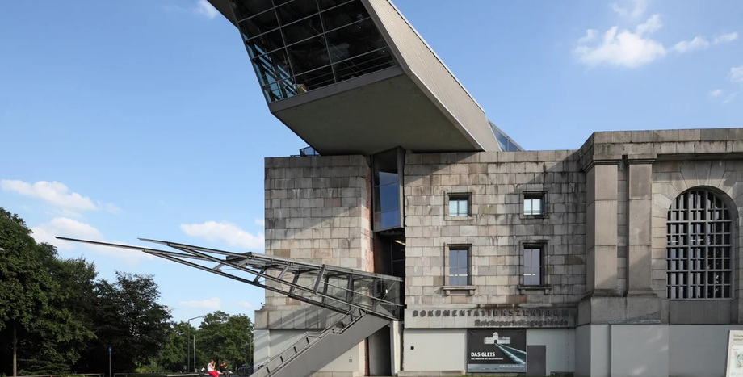
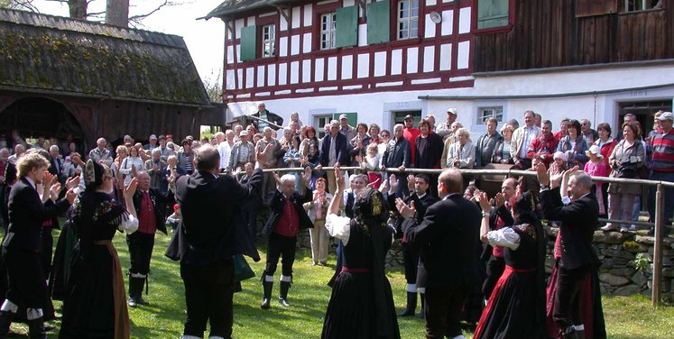
#UNEXPECTED
possibilities
Mödlareuth
Levi Strauss Museum
A rural village divided by the Inner German Border, now housing a museum dedicated to the Cold War division.
Trace the roots of the American blue jean icon back to his Franconian birthplace.
Documentation Center Nazi Party Rally Grounds
Kleinlosnitz
An authentic step back in time into traditional rural Franconian farm life.
A historical complex containing monumental architecture from the National Socialist era, used for mass propaganda rallies.

Slide 12
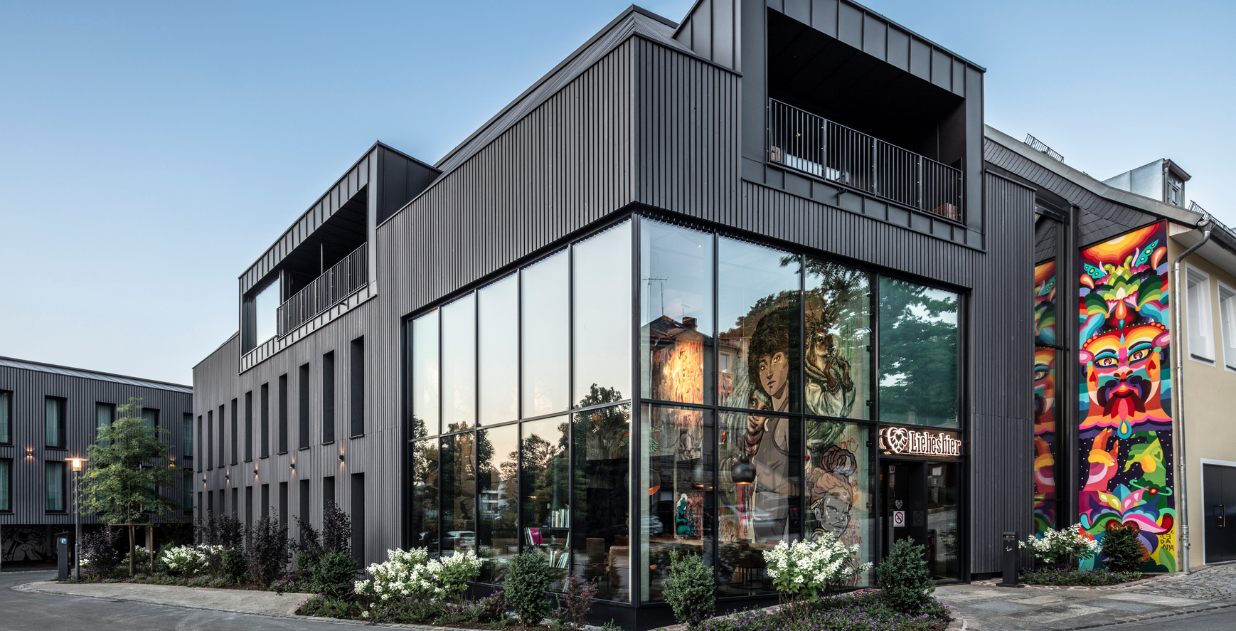
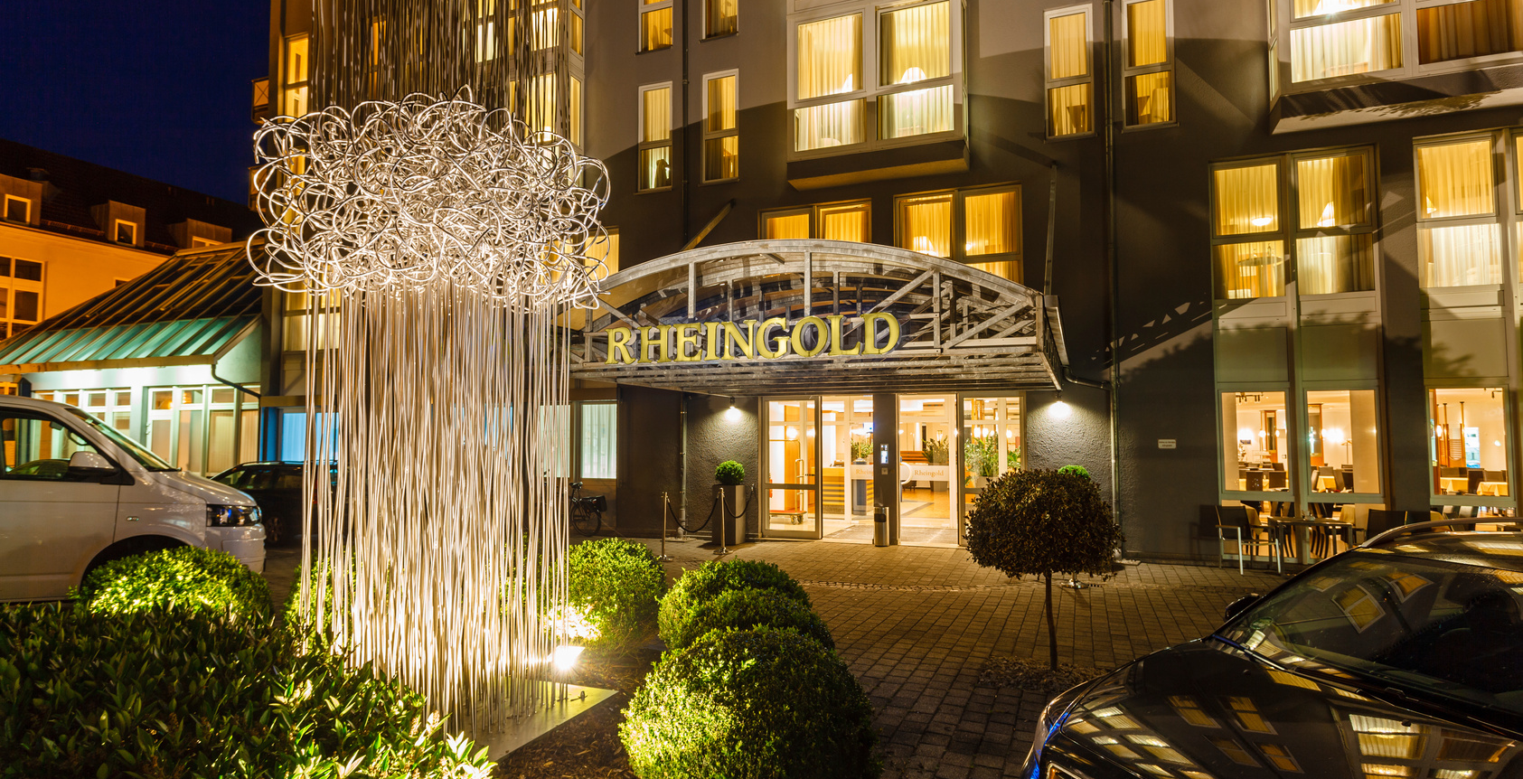
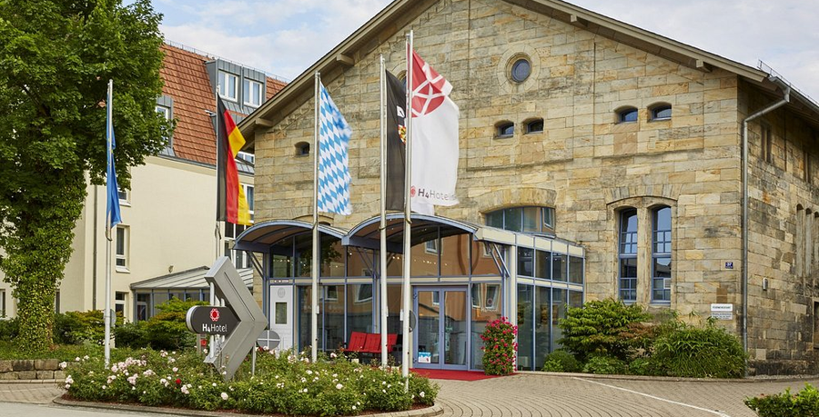
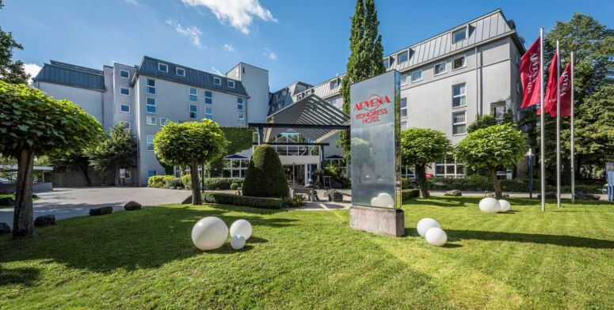
#UNEXPECTED
possibilities
Urban Art Hotel
Hotel Rheingold
128
293
120-140€ per room/night
100-120€ per room/night
Urban Art Hotel
Arvena Kongress 4*
209
390
100-130€ per room/night
110-130€ per room/night

Slide 13
#UNEXPECTED
bayreuth
Why Bayreuth?
  Unexpected good location: Excellent connection to international Airports
  Unexpected UNESCO: 12 sites in less than 3 hours
  Unexpected variety of beer: highest density of breweries in the world
  Unexpected green: located between the Fichtel Mountains and Franconian Switzerland
  Unexpected price value ratio
  Unexpected “undercrowded”: Rising star without overtourism

